Slide 1
SQL STRUCTURED QUERY LANGUAGE
Name: Shaik Musthak Basha
Phone No: 9515725502

Slide 2
SQL – Structured query language
SQL stands for Structured Query Language.
It is used to communicate with and manage databases.
SQL is the standard language for Relational Database Management Systems (RDBMS).
To effectively examine and work with data.
To create, read, update, and delete data (CRUD operations).

Slide 3
Main SQL command categories:
DDL - Data Definition Language
DML - Data Manipulation Language
DQL - Data Query Language
TCL - Transaction Control Language
DCL - Data Control Language

Slide 4
DDL (Data Definition Language):
Used to specify and control the database's structure
and its elements, such as tables, schemas, and indexes.
DML (Data Manipulation Language):
Used to change and alter the information kept in a database.
DQL (Data Query Language): Utilized for accessing and query data from databases.
TCL (Transaction Control Language):
Controls database transactions to ensure the reliability and accuracy of data.
DCL (Data Control Language):
Establishes security settings and user rights to limit access to data

Slide 5
SQL Functions:
Aggregate Functions (SUM, AVG, COUNT, etc.).
String Functions (CONCAT, LENGTH, UPPER, etc.).
SQL Keys:
Discuss the types of keys used in databases:
Primary Key: Ensures each record is unique.
Foreign Key: Maintains relationships between tables
Unique Key: Prevents duplicate values in a column.
SQL Joins:
Describe how to merge data from different tables.
Cartesian Join, Inner Join, Outer Join, Natural Join, Self Join

Slide 6
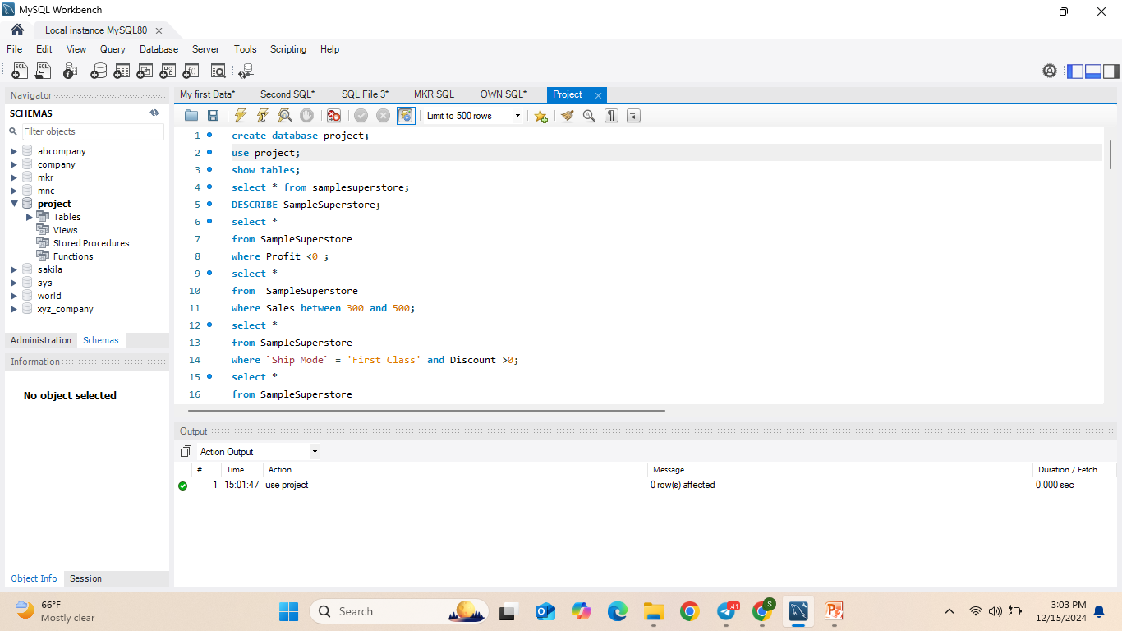
Creating a Database

Slide 7
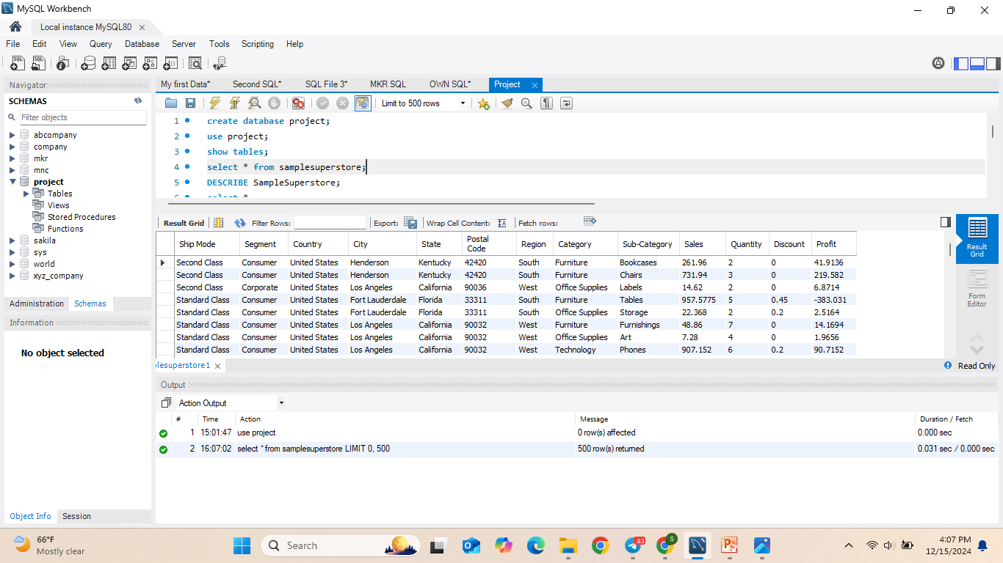
Table: Samplesuperstore

Slide 8
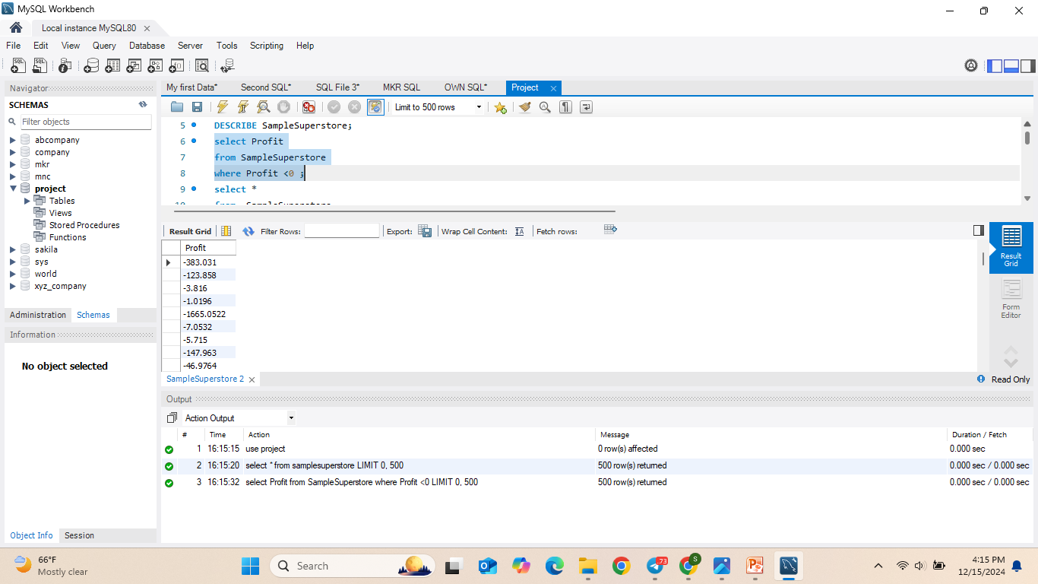
1)Write an SQL query to display the Profit from the SampleSuperstore table where the profit is less than zero.
*WHERE – Used to filter records based on a specified condition.

Slide 9
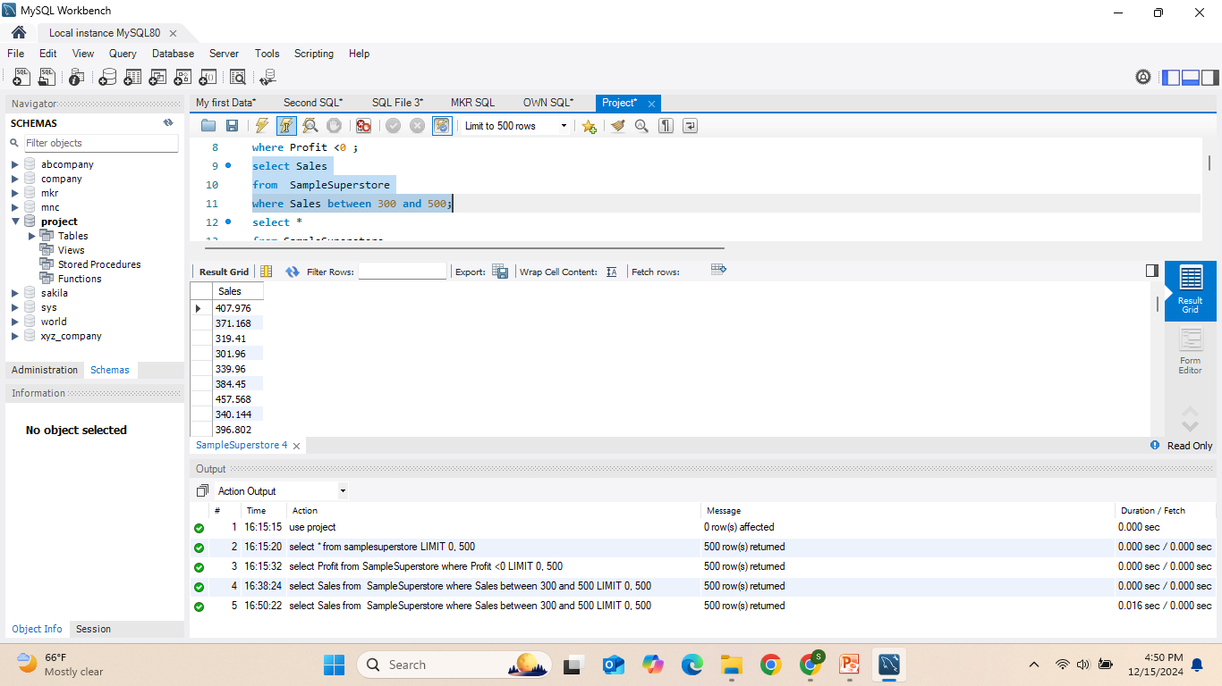
2)Write an SQL query to display the Sales from the SampleSuperstore table where the sales are between 300 and 500.
* BETWEEN – Used to filter records within a specified range, inclusive of the boundary values.

Slide 10
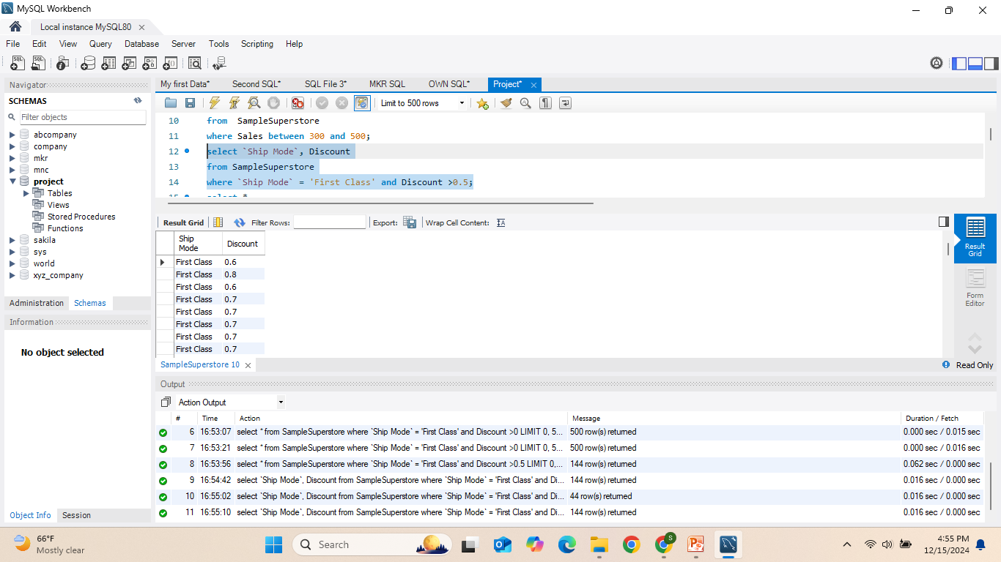
3)Write an SQL query to display the Ship Mode and Discount from the SampleSuperstore table where the Ship Mode is 'First Class' and the Discount is greater than 0.5.
*AND – Used to combine multiple conditions in a WHERE clause, ensuring that all conditions are true.

Slide 11
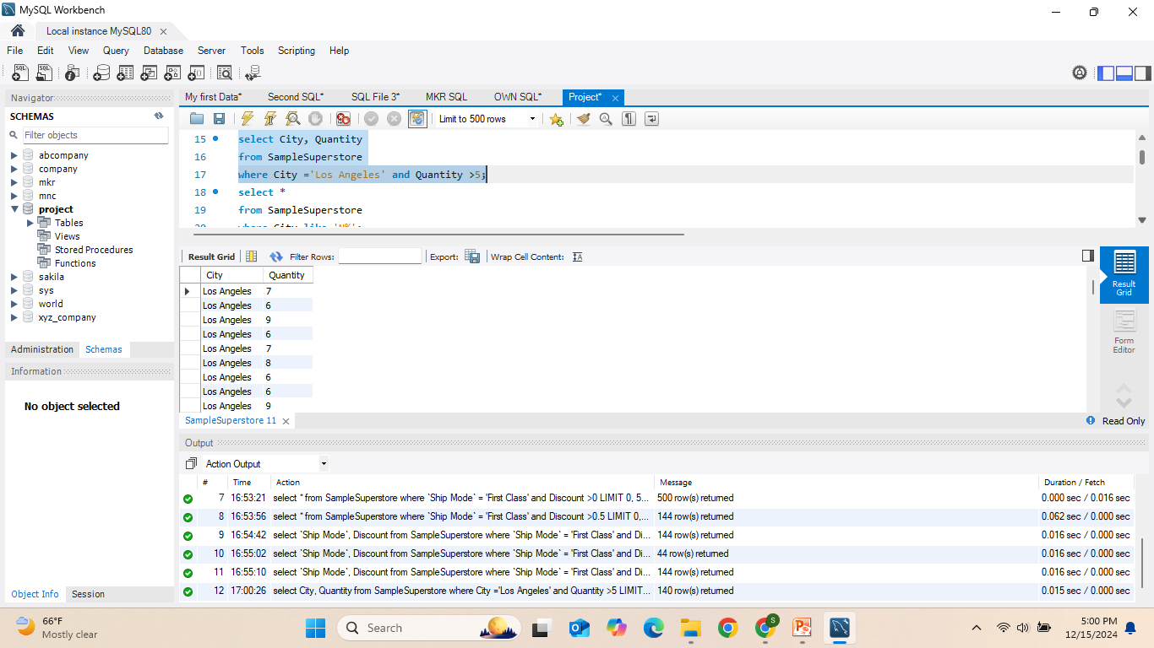
4)Write an SQL query to display the City and Quantity from the SampleSuperstore table where the City is 'Los Angeles' and the Quantity is greater than 5.
* AND – Used to combine multiple conditions in the WHERE clause, ensuring that all conditions must be true.

Slide 12
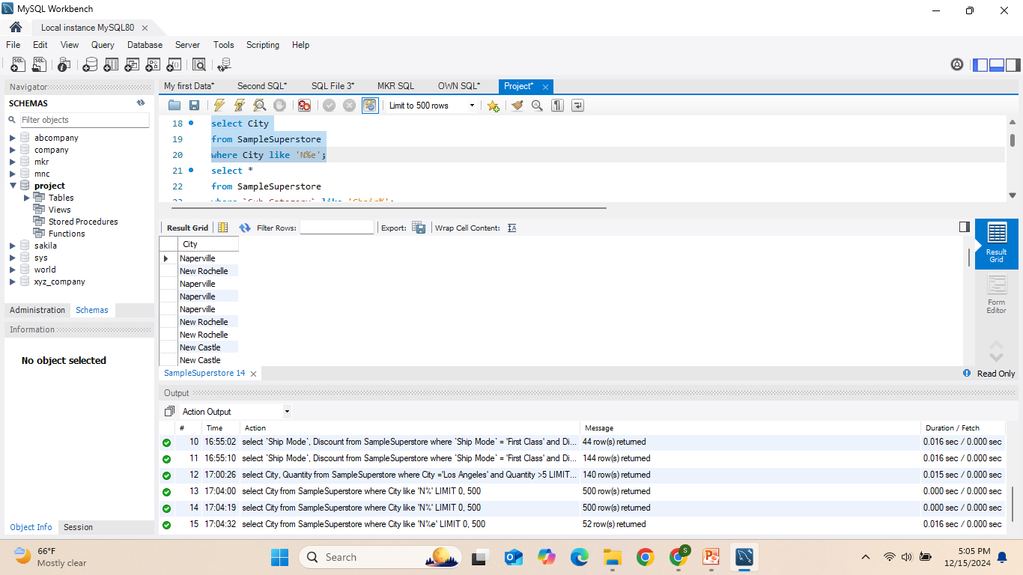
5)Write an SQL query to display the City from the SampleSuperstore table where the City name starts with 'N' and ends with 'e'.
*LIKE – Used to search for a specified pattern in a column, often with wildcard characters (% for any sequence of characters, _ for a single character).

Slide 13
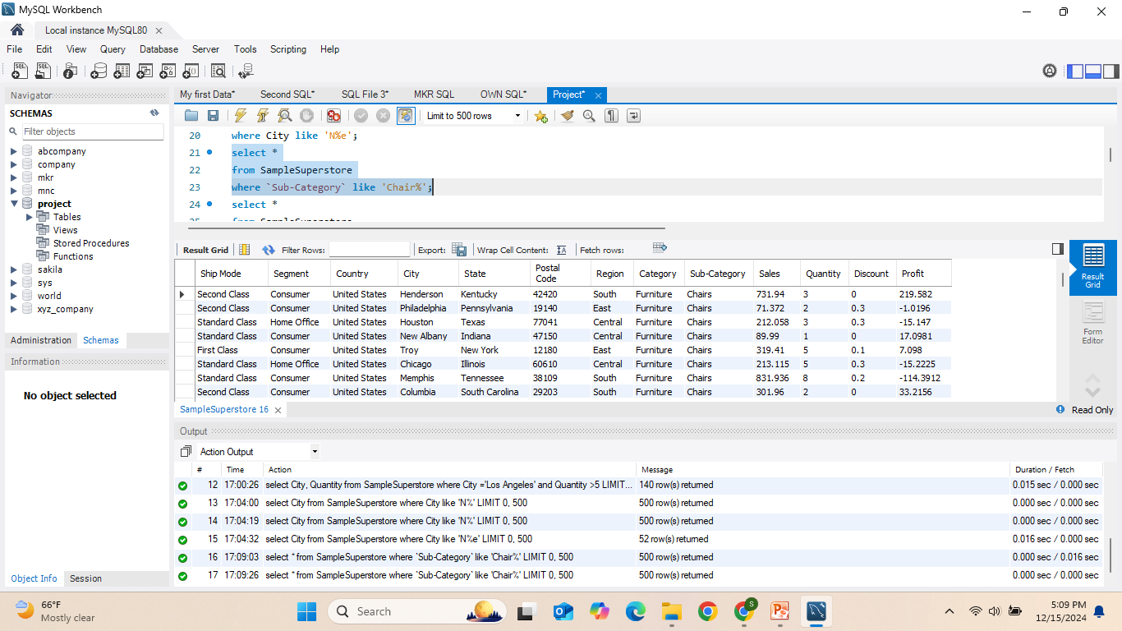
6)Write an SQL query to display all records from the SampleSuperstore table where the Sub-Category starts with 'Chair'.
* LIKE – Used to search for a specified pattern in a column. The % wildcard represents any sequence of characters.

Slide 14
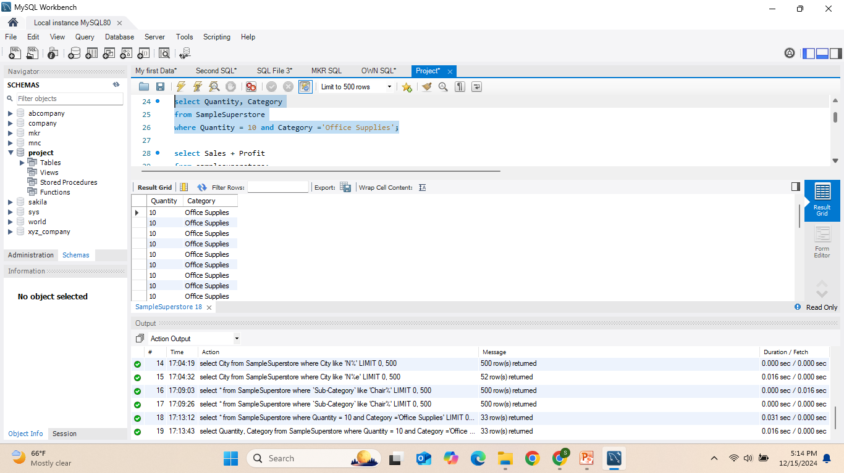
7)Write an SQL query to display the Quantity and Category from the SampleSuperstore table where the Quantity is 10 and the Category is 'Office Supplies'.
* AND – Used to combine multiple conditions in the WHERE clause, ensuring that all conditions must be true.

Slide 15
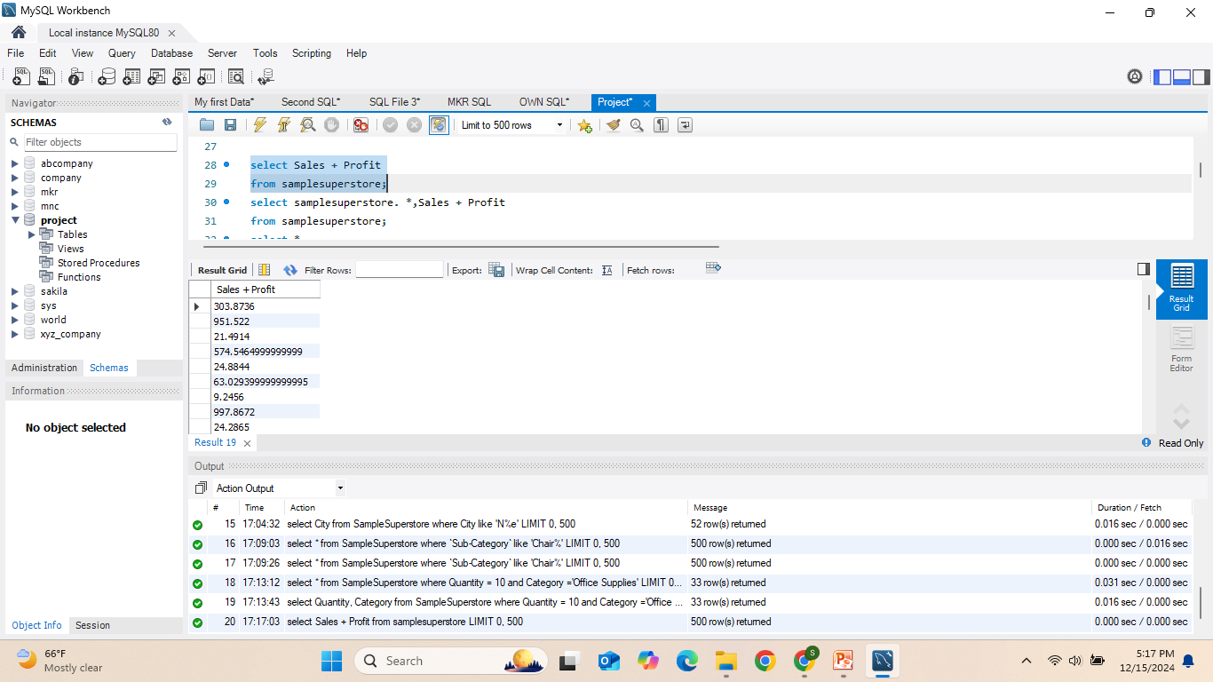
8)Write an SQL query to display the sum of Sales and Profit from the SampleSuperstore table.
* + (Addition Operator) – Used to add values from two or more columns in the SELECT statement.

Slide 16
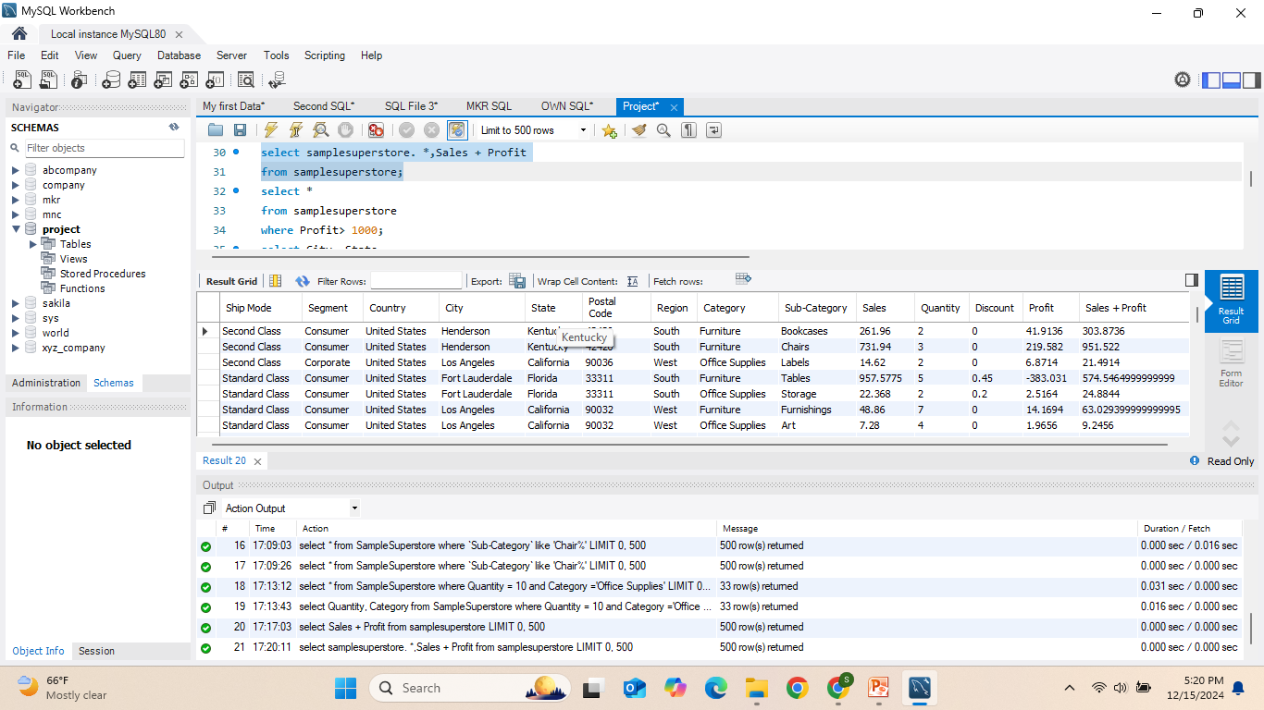
9)Write an SQL query to display all columns from the SampleSuperstore table along with the sum of Sales and Profit.

Slide 17
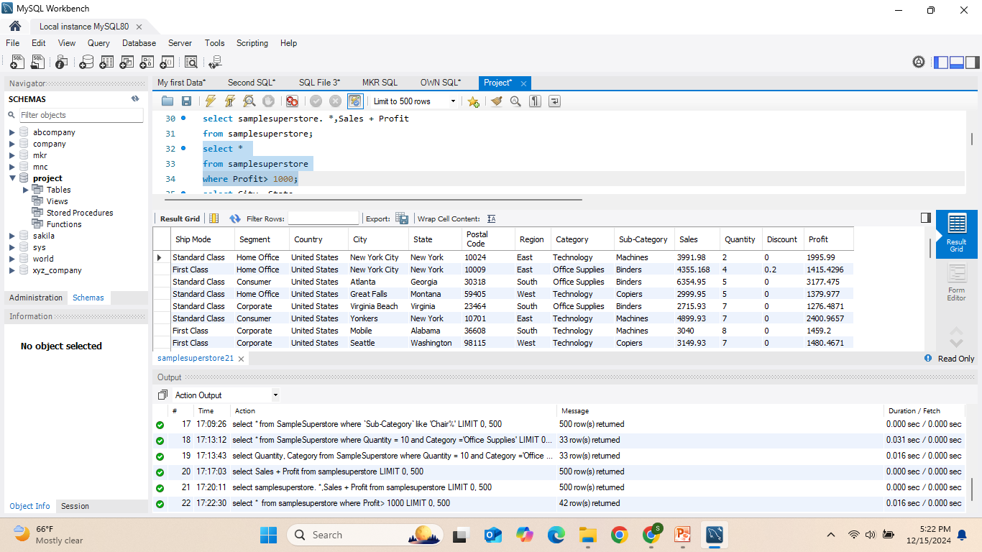
10)Write an SQL query to display all records from the SampleSuperstore table where the Profit is greater than 1000.
* WHERE – Used to filter records based on a specified condition.

Slide 18
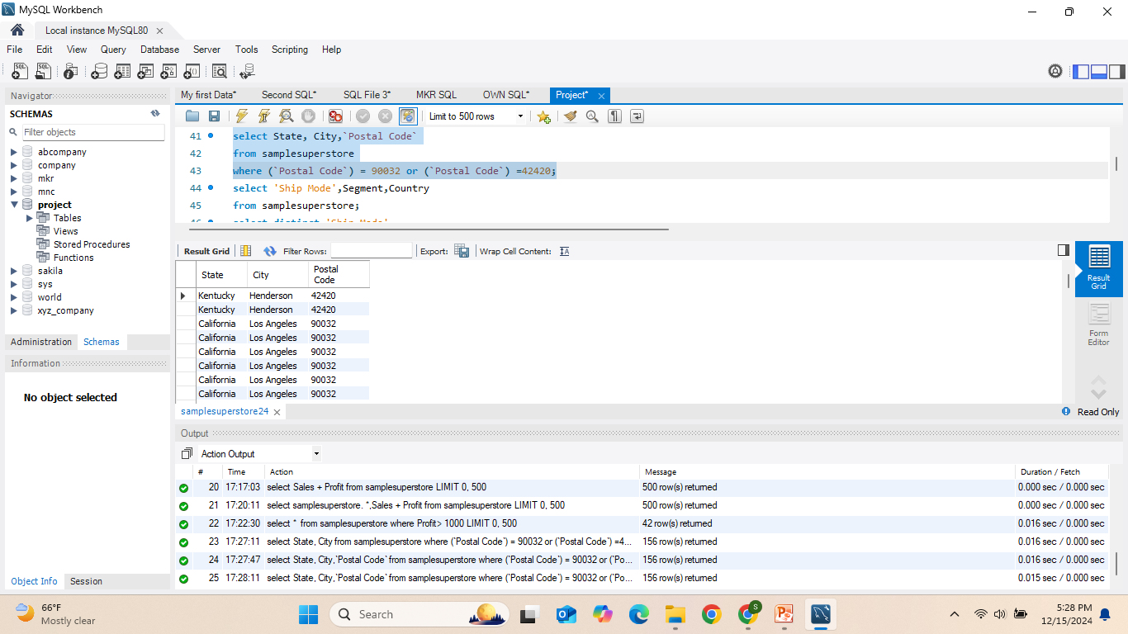
11)Write an SQL query to display the State, City, and Postal Code from the SampleSuperstore table where the Postal Code is either 90032 or 42420.
* OR – Used to combine multiple conditions in the WHERE clause, where at least one condition must be true.

Slide 19
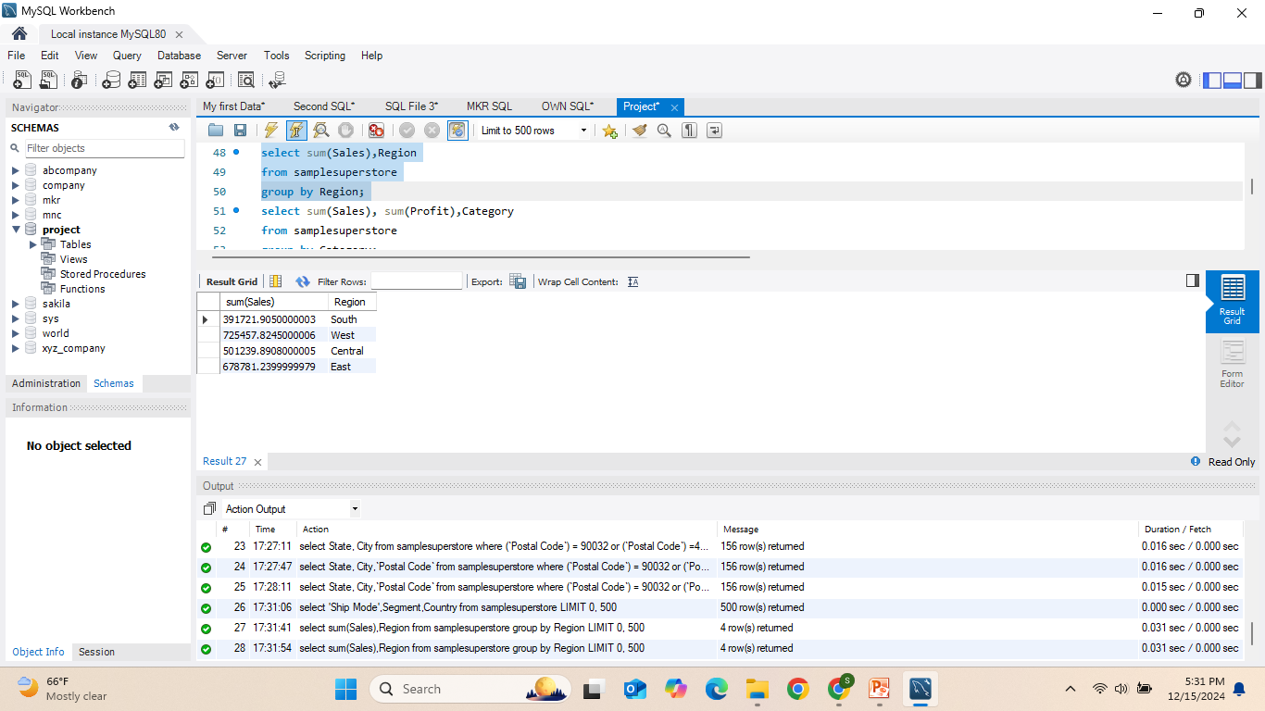
12)Write an SQL query to display the total Sales for each Region from the SampleSuperstore table.
* GROUP BY – Used to group rows that have the same values in specified columns, often used with aggregate functions like SUM(), COUNT(), AVG(), etc.

Slide 20
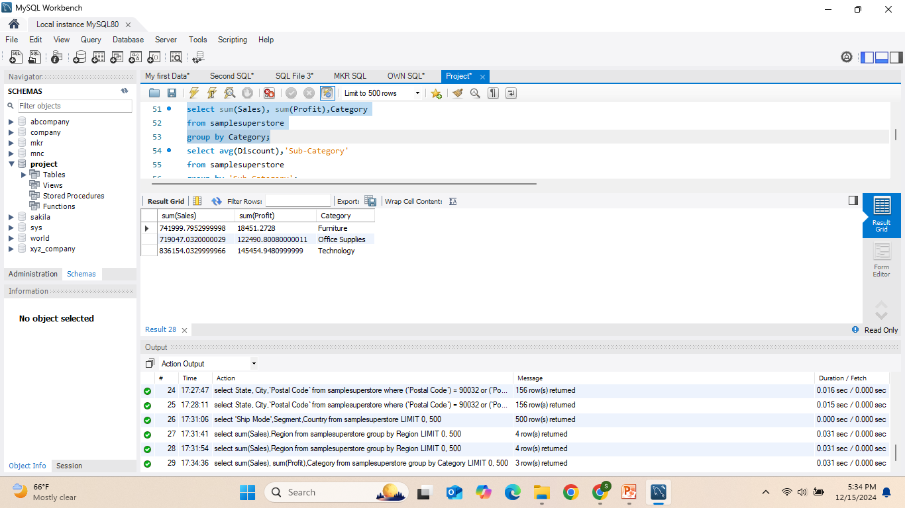
13)Write an SQL query to display the total Sales and Profit for each Category from the
* GROUP BY – Used to group rows that have the same values in specified columns, often combined with aggregate functions like SUM().

Slide 21
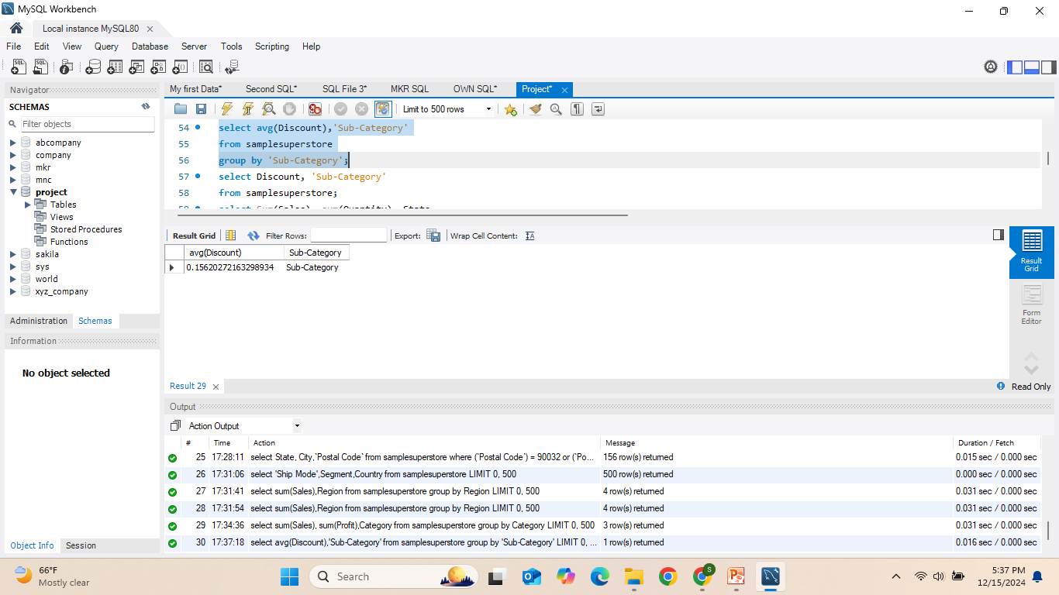
14)Write an SQL query to display the average Discount for each Sub-Category from the
* GROUP BY – Used to group rows that have the same values in a specified column, combined with aggregate functions like AVG() to calculate averages for each group.

Slide 22
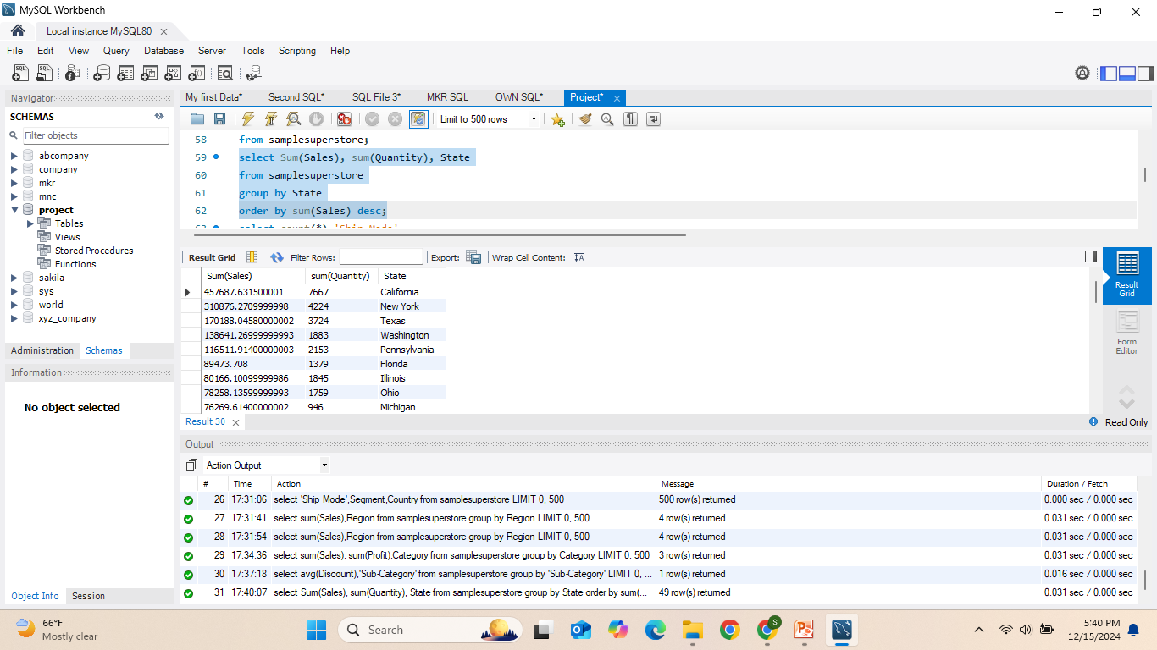
15)Write an SQL query to display the total Sales and Quantity for each State from the SampleSuperstore table, ordered by total Sales in descending order.
* ORDER BY – Used to sort the result set based on one or more columns, and DESC specifies descending order.

Slide 23
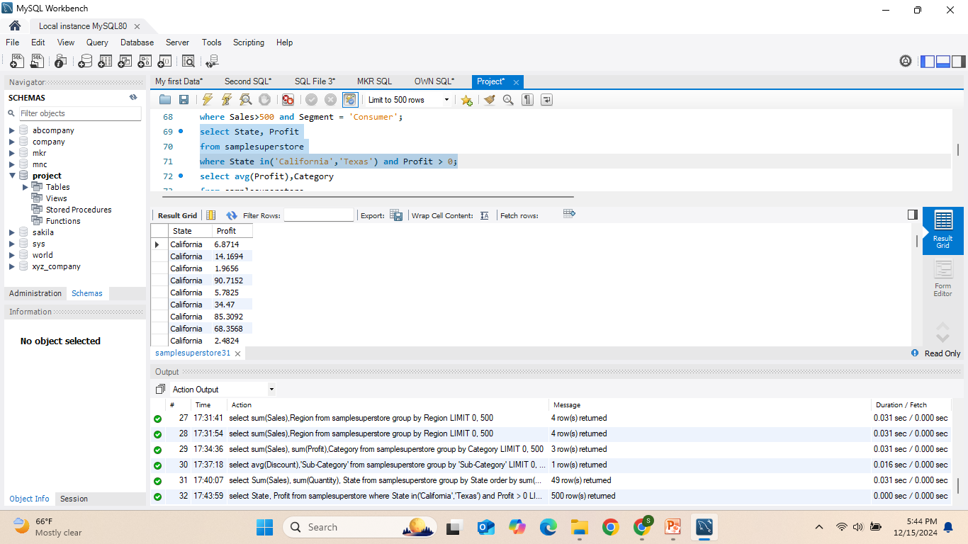
16)Write an SQL query to display the State and Profit from the SampleSuperstore table where the State is either 'California' or 'Texas' and the Profit is greater than 0.
* IN – Used to specify multiple possible values for a column in a WHERE clause.

Slide 24
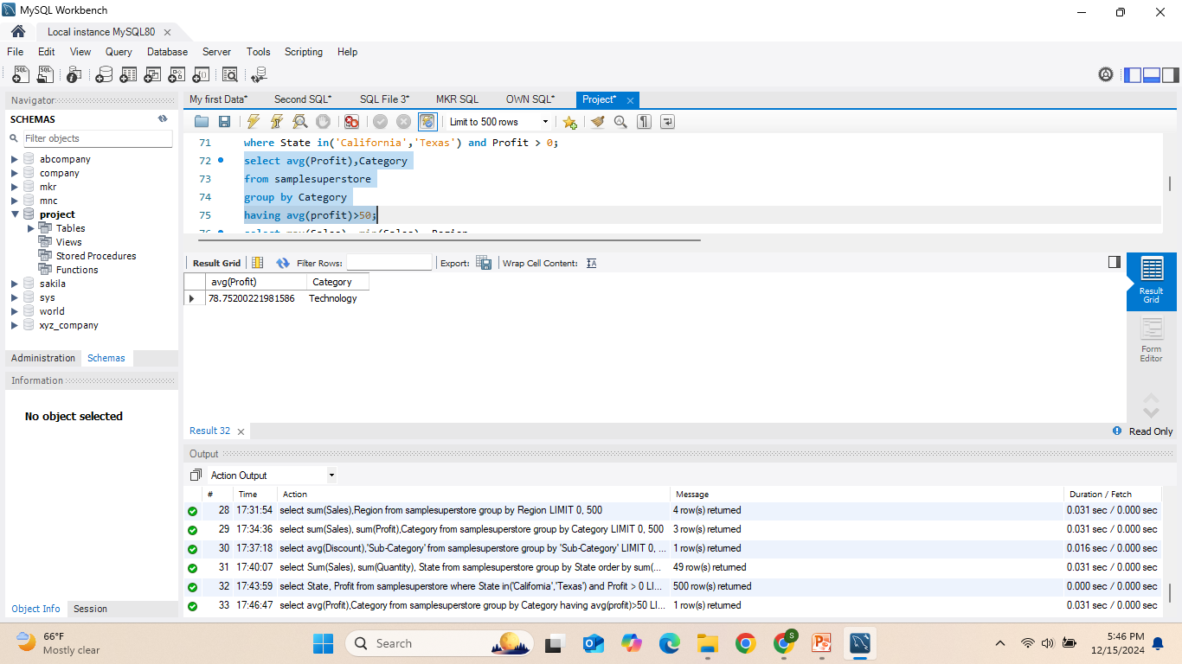
17)Write an SQL query to display the average Profit for each Category from the SampleSuperstore table, where the average profit is greater than 50.
* HAVING – Used to filter groups after the GROUP BY clause, often combined with aggregate functions like AVG().

Slide 25
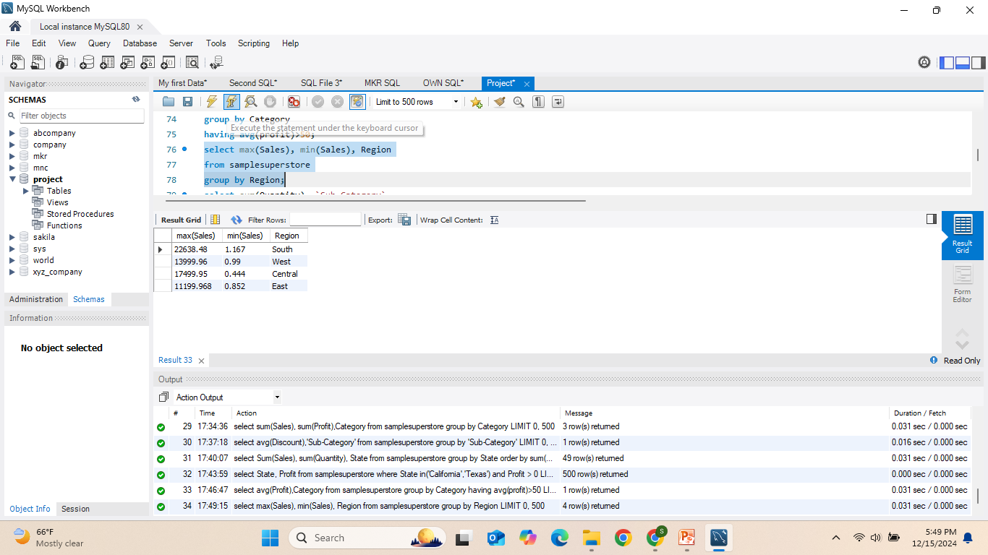
18)Write an SQL query to display the maximum and minimum Sales for each Region from the SampleSuperstore table.
* GROUP BY – Used to group rows that have the same values in specified columns, often combined with aggregate functions like MAX() and MIN().

Slide 26
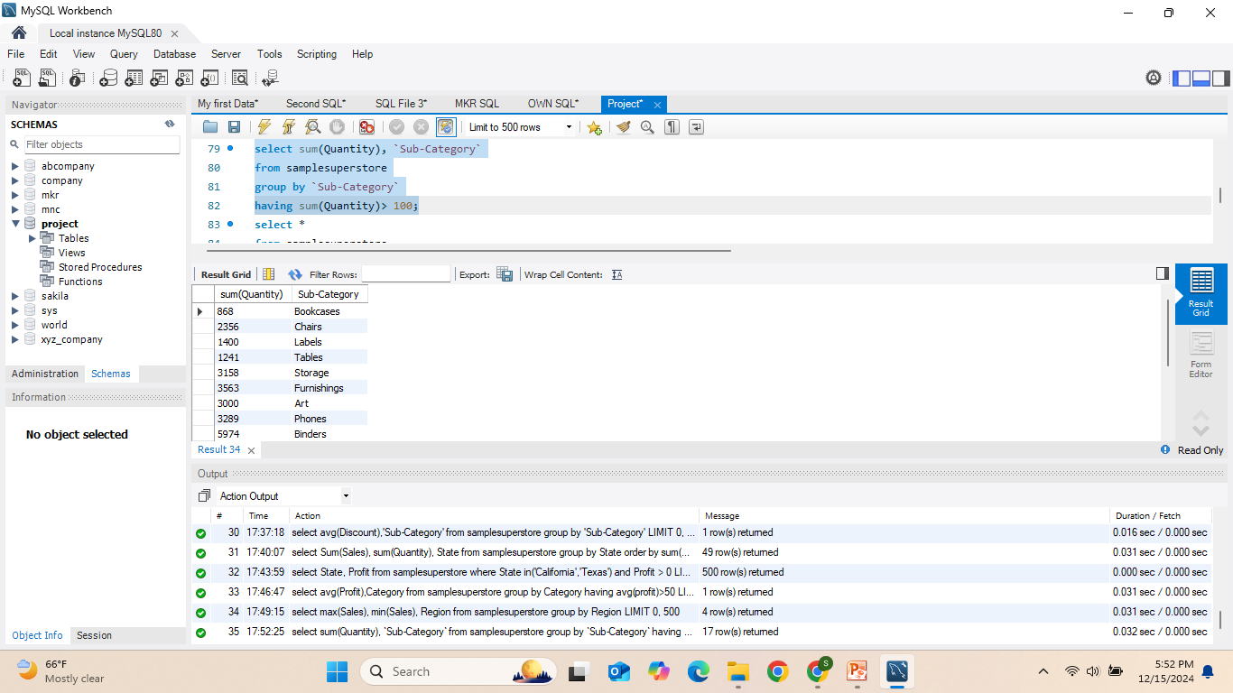
19)Write an SQL query to display the total Quantity for each Sub-Category from the SampleSuperstore table, where the total quantity is greater than 100.
* HAVING – Used to filter the results of a GROUP BY query based on aggregate functions like SUM().

Slide 27
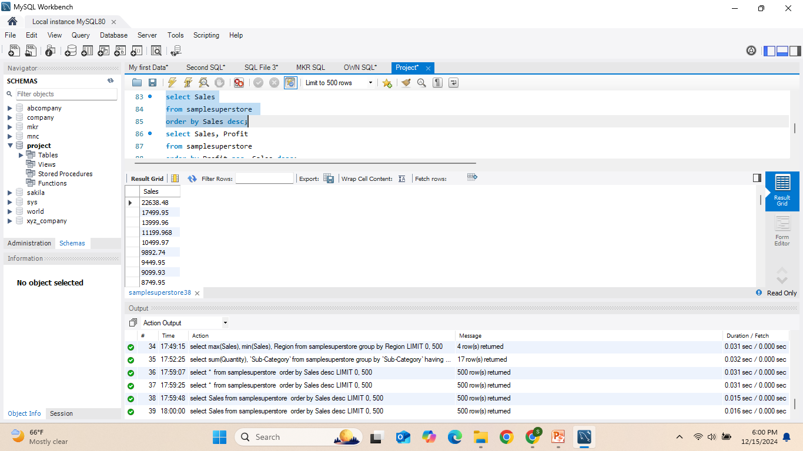
20) Write an SQL query to display the Sales from the SampleSuperstore table, ordered in descending order.
* ORDER BY – Used to sort the result set based on one or more columns, and DESC specifies descending order.

Slide 28
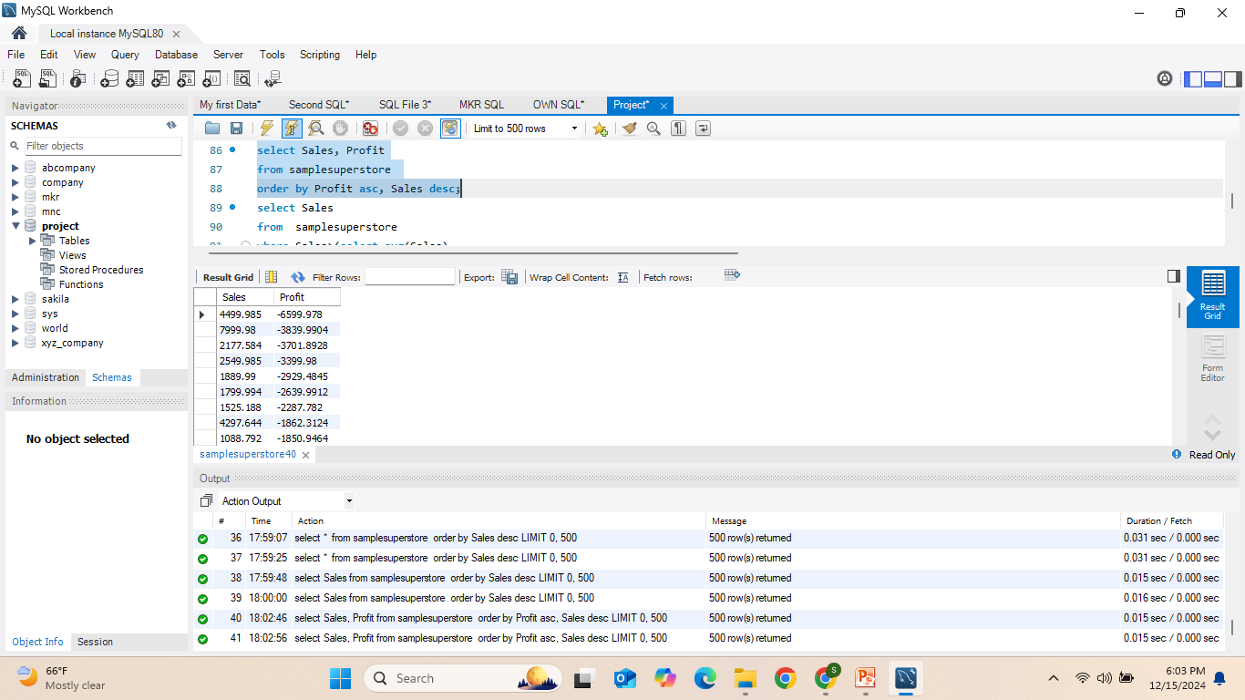
21)Write an SQL query to display the Sales and Profit from the SampleSuperstore table, ordered by Profit in ascending order and Sales in descending order.
* ORDER BY – Used to sort the result set based on one or more columns. ASC specifies ascending order, and DESC specifies descending order.

Slide 29
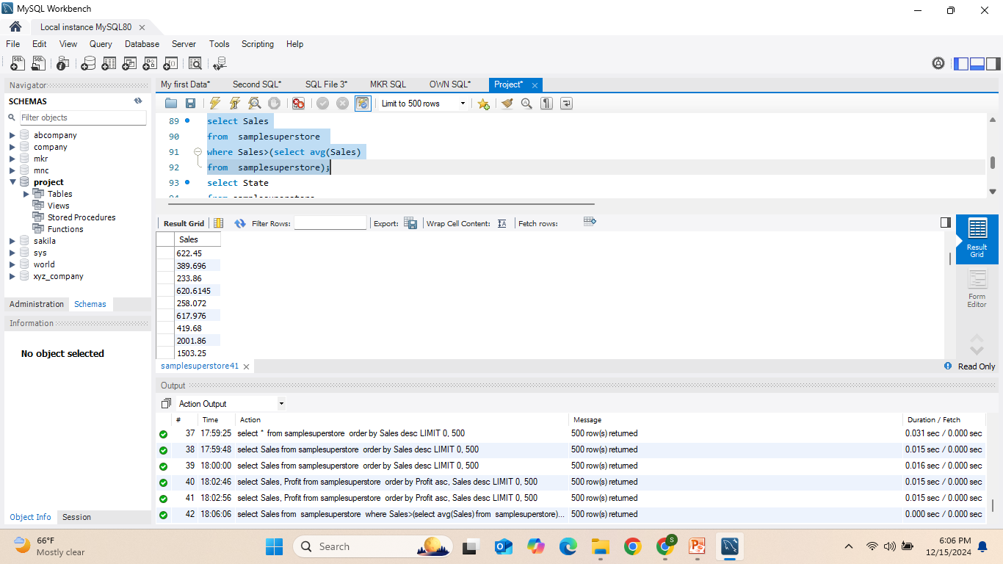
22)Write an SQL query to display the Sales from the SampleSuperstore table where the Sales are greater than the average Sales from the same table.
* Subquery – A query embedded inside another query, often used in the WHERE, HAVING, or FROM clause. In this case, it's used to calculate the average sales.

Slide 30
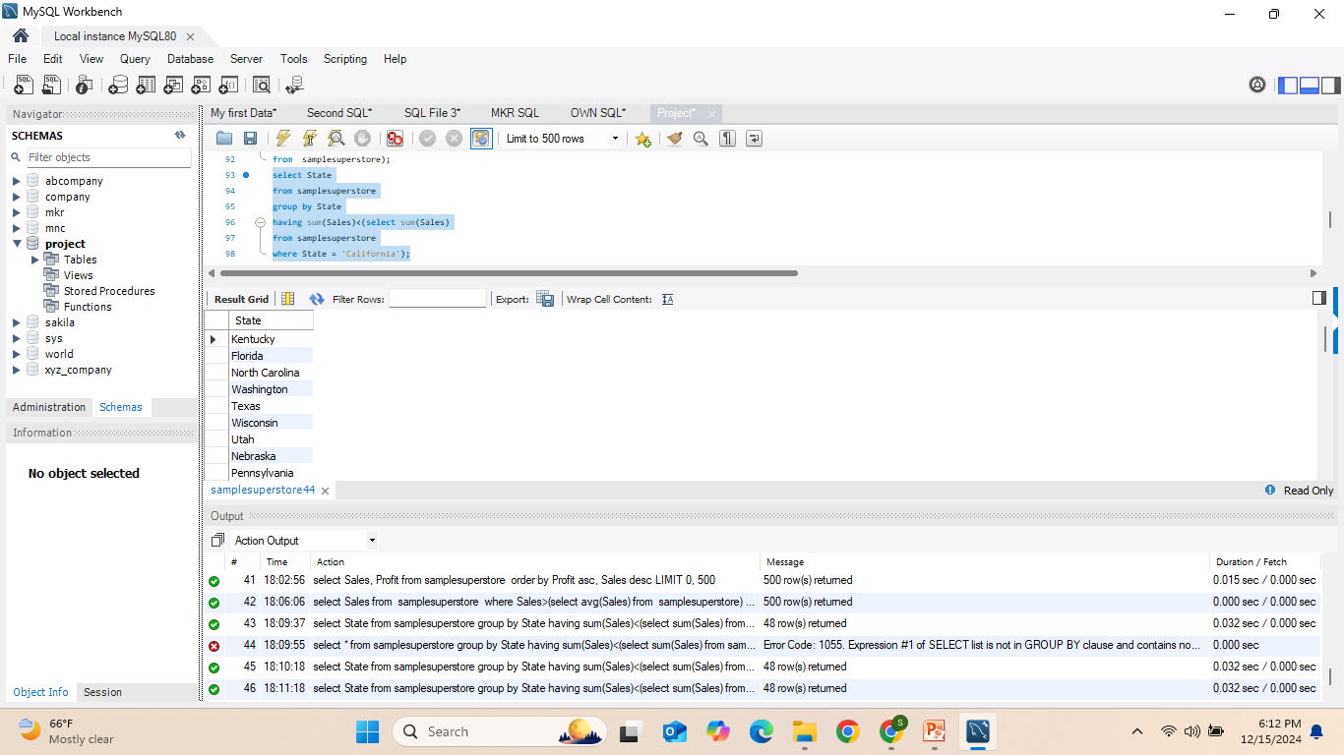
23) Write an SQL query to display the State from the SampleSuperstore table where the total Sales in each state are less than the total Sales in 'California'.
* Subquery – A query embedded within another query, used here to compare total sales for each state to the total sales in California. HAVING – Used to filter results after the GROUP BY clause, typically with aggregate functions like SUM().

Slide 31
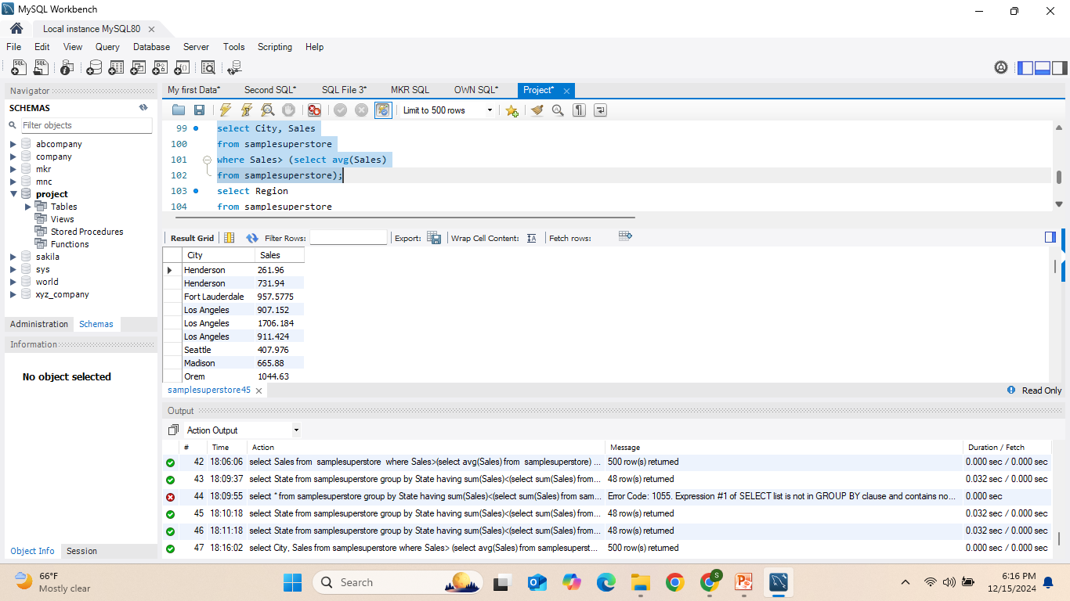
24)Write an SQL query to display the City and Sales from the SampleSuperstore table where the Sales are greater than the average Sales across all records.
* Subquery – A query embedded within another query, used here to calculate the average sales for comparison.

Slide 32
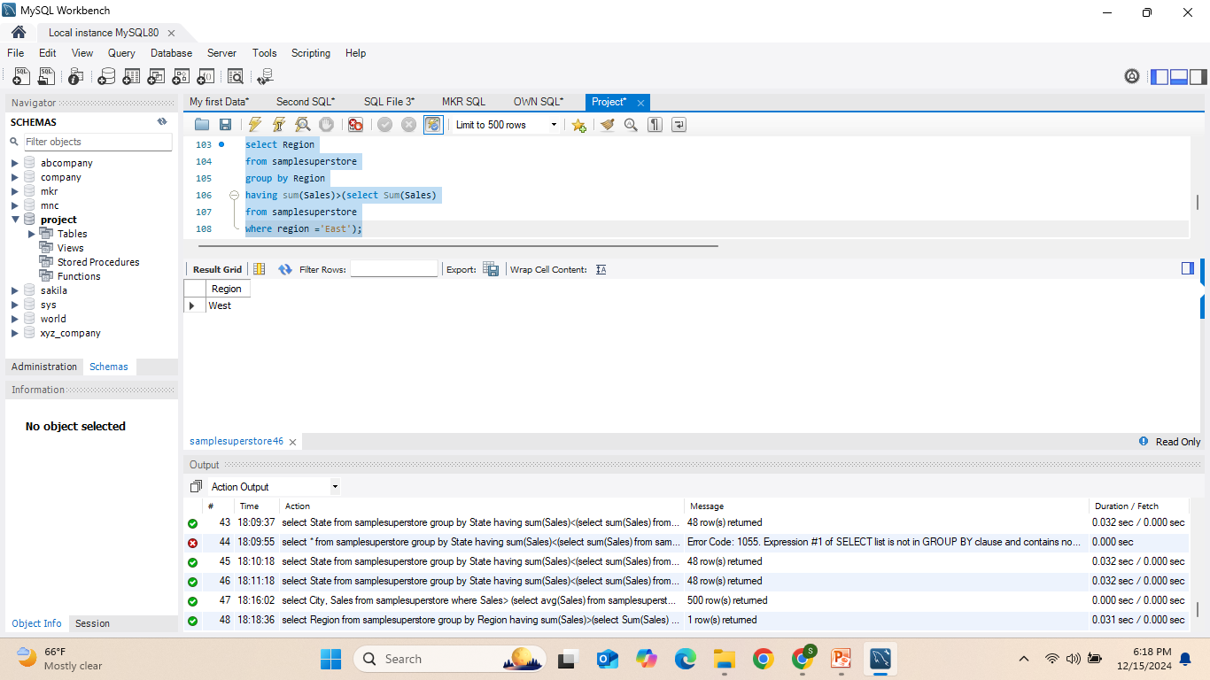
25)Write an SQL query to display the Region from the SampleSuperstore table where the total Sales in that region are greater than the total Sales in the 'East' region.
* HAVING – Used to filter results after the GROUP BY clause based on aggregate functions. Subquery – A query within another query, used here to calculate the total sales for the 'East' region.

Slide 33
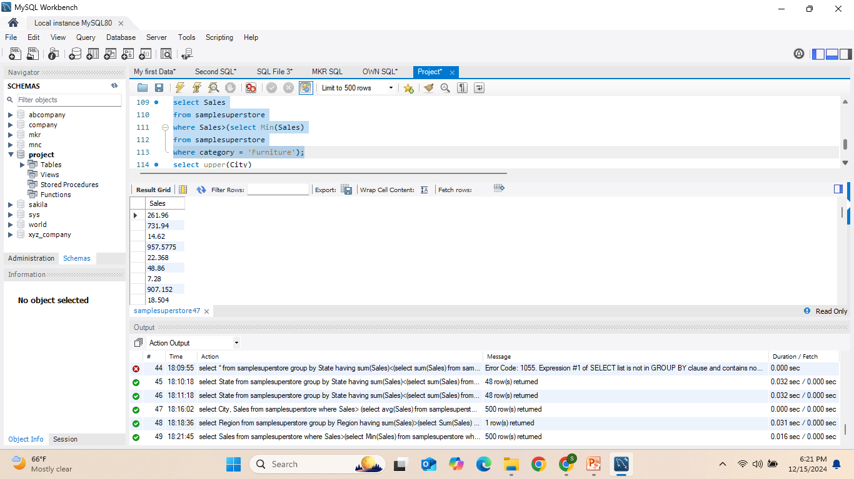
26) Write an SQL query to display the Sales from the SampleSuperstore table where the Sales are greater than the minimum Sales recorded in the 'Furniture' category.
* Subquery – A query embedded within another query, used here to determine the minimum sales in the 'Furniture' category for comparison.

Slide 34
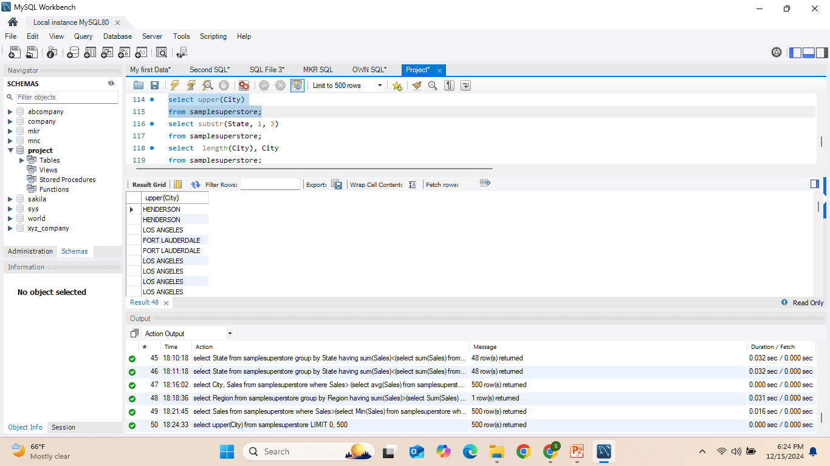
27) Write an SQL query to display the names of all City values from the SampleSuperstore table in uppercase.
* UPPER() – A function used to convert text to uppercase.

Slide 35
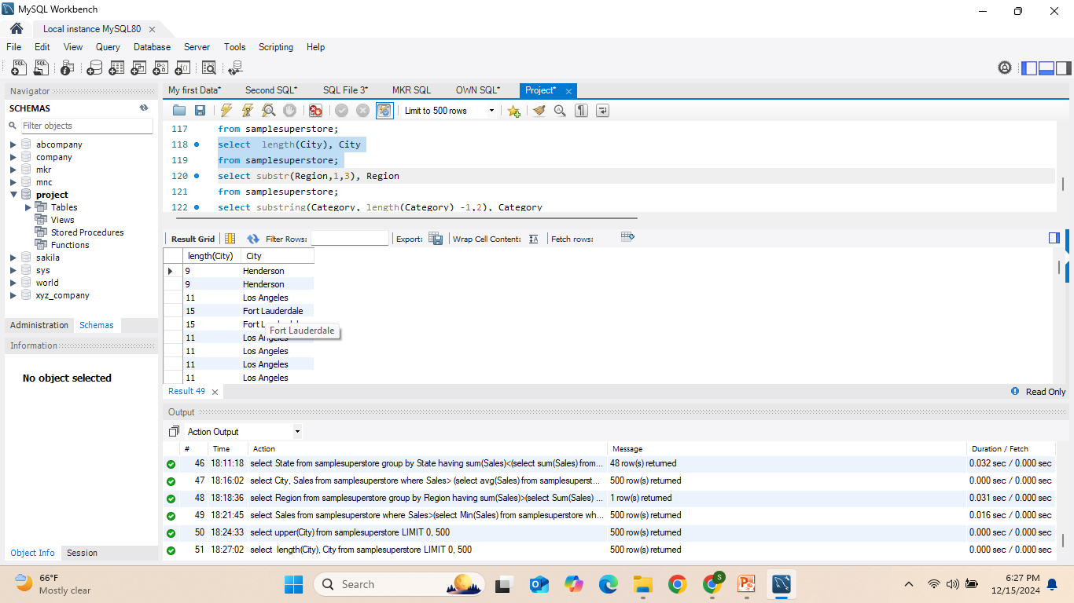
28) Write an SQL query to display the length of each City name along with the City itself from the SampleSuperstore table.
* LENGTH() – A function used to calculate the number of characters in a string, including spaces.

Slide 36
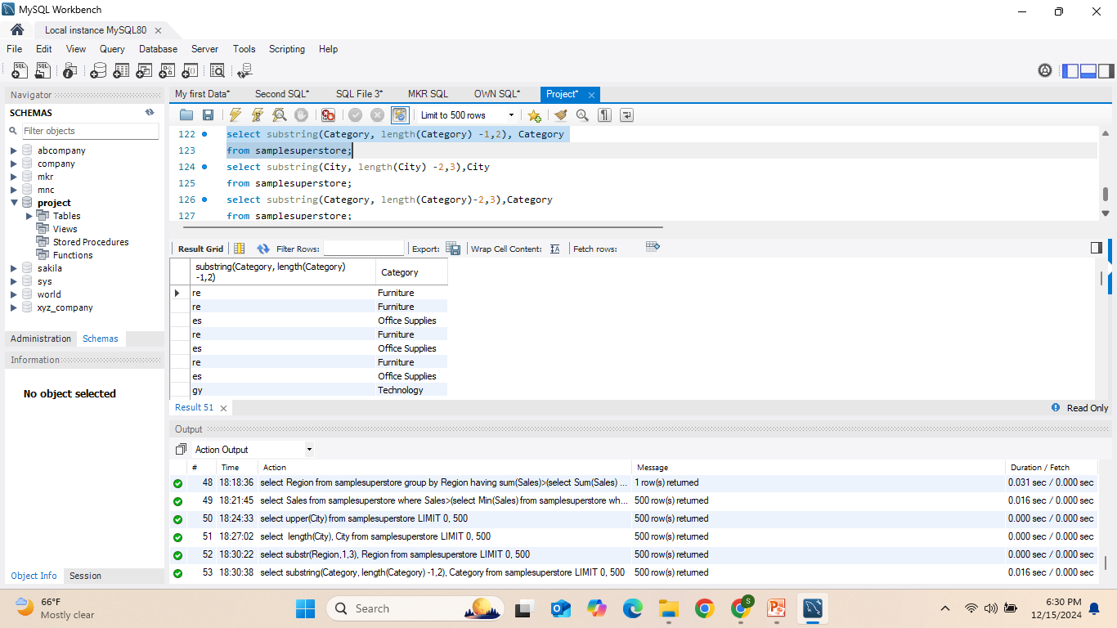
29) Write an SQL query to display the last two characters of each Category along with the full Category name from the SampleSuperstore table.

Slide 37
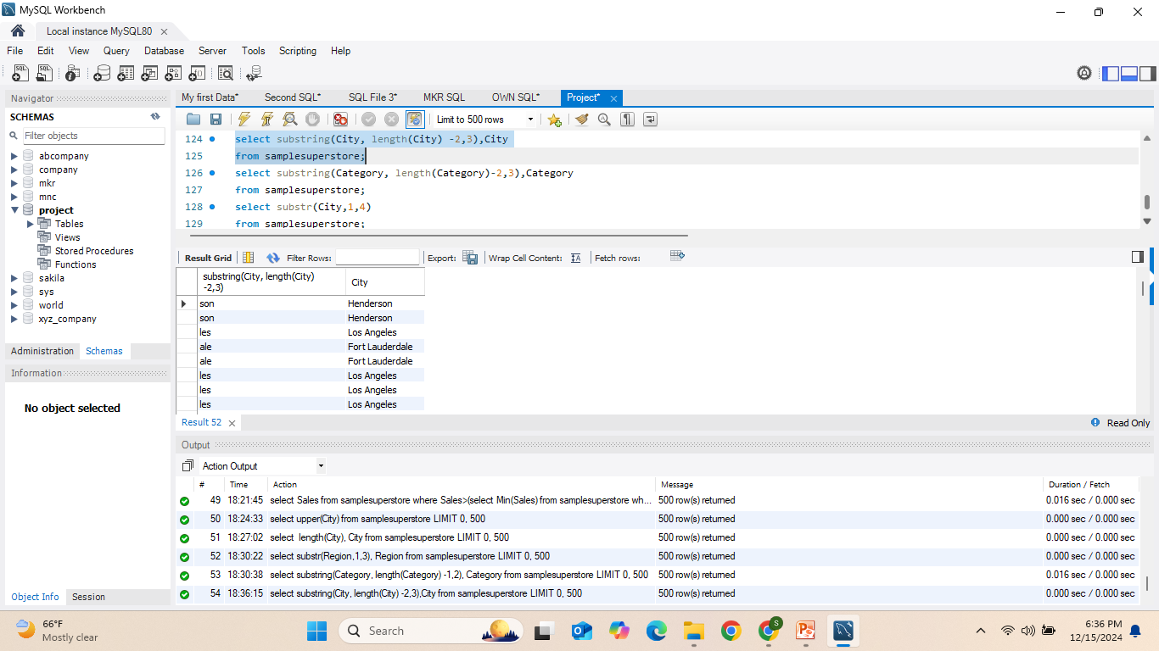
30) Write an SQL query to display the last three characters of each City name along with the full City name from the SampleSuperstore table.

Slide 38
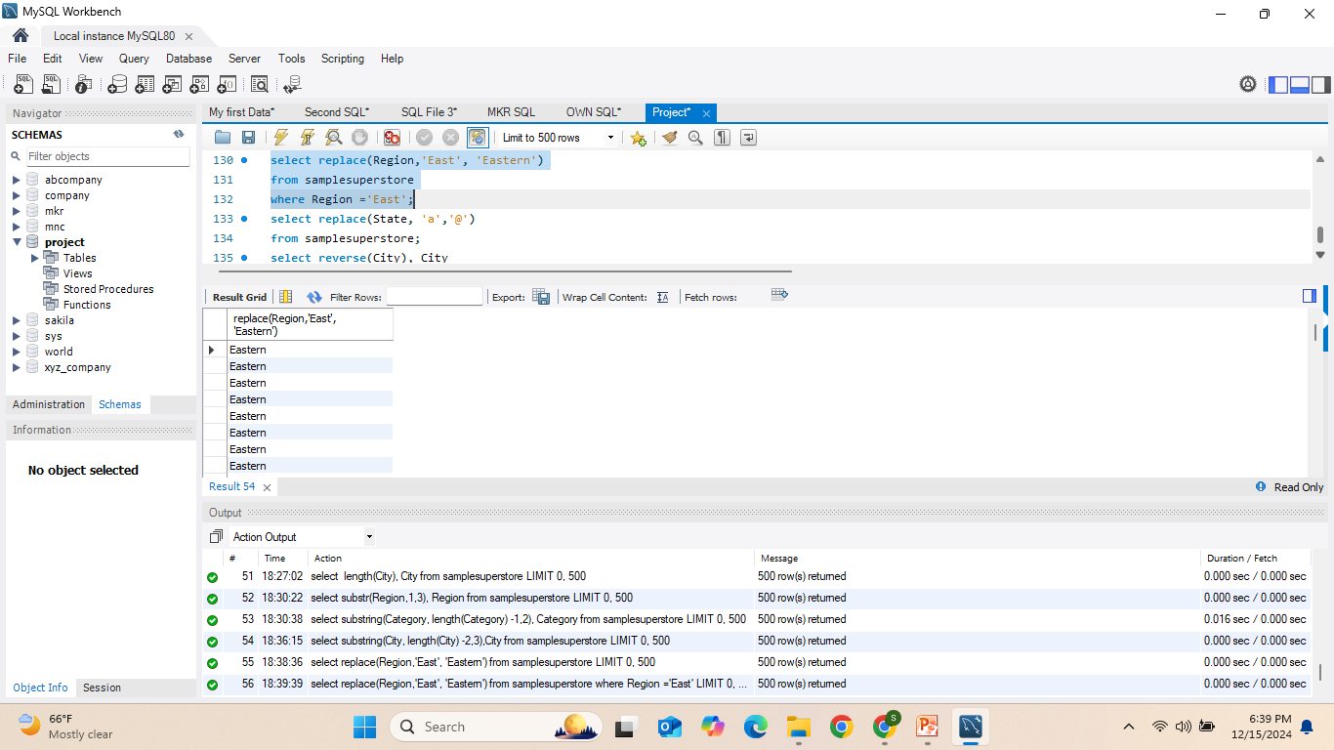
31)Write an SQL query to replace the value 'East' with 'Eastern' in the Region column and display the updated Region values from the SampleSuperstore table where the Region is 'East'.
* REPLACE() – A function used to substitute all occurrences of a specified substring within a string with another substring.

Slide 39
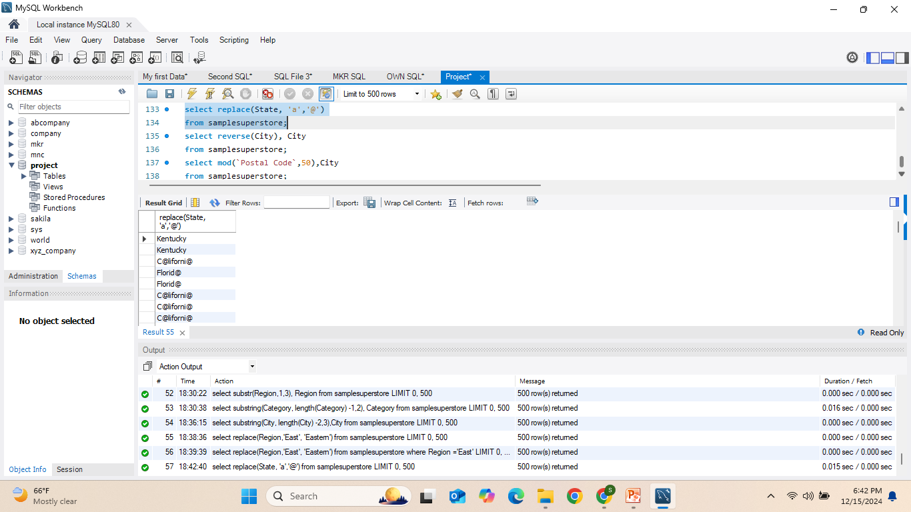
32) Write an SQL query to replace every occurrence of the letter 'a' with '@' in the State column and display the updated State values from the SampleSuperstore table.

Slide 40
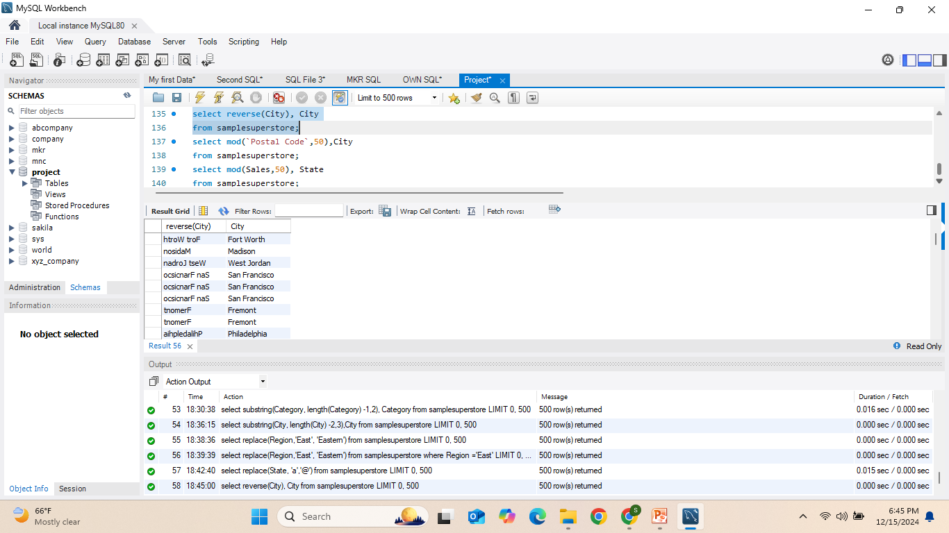
33) Write an SQL query to display the reversed version of each City name along with the original City name from the SampleSuperstore table.
* REVERSE() – A function used to reverse the order of characters in a string.

Slide 41
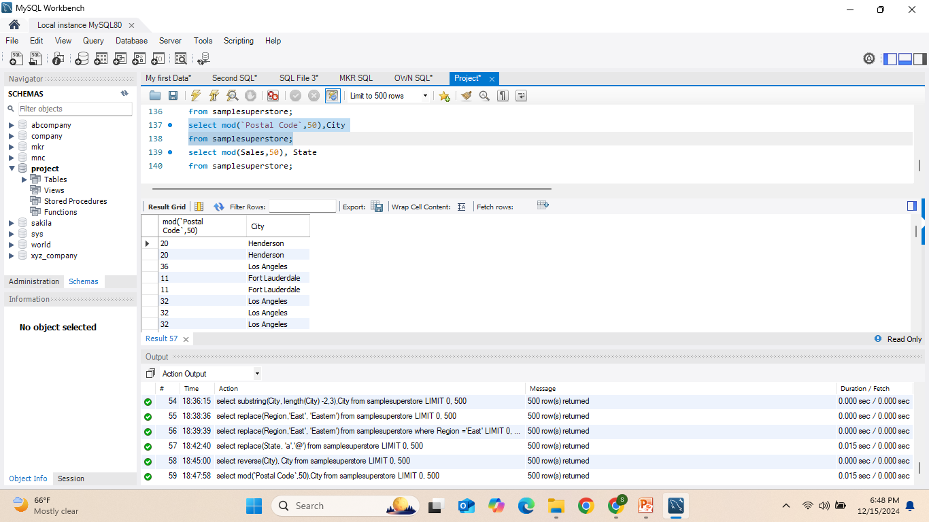
34) Write an SQL query to display the remainder when the Postal Code is divided by 50, along with the corresponding City from the SampleSuperstore table.
* MOD() – A function used to return the remainder of a division operation (modulus).

Slide 42
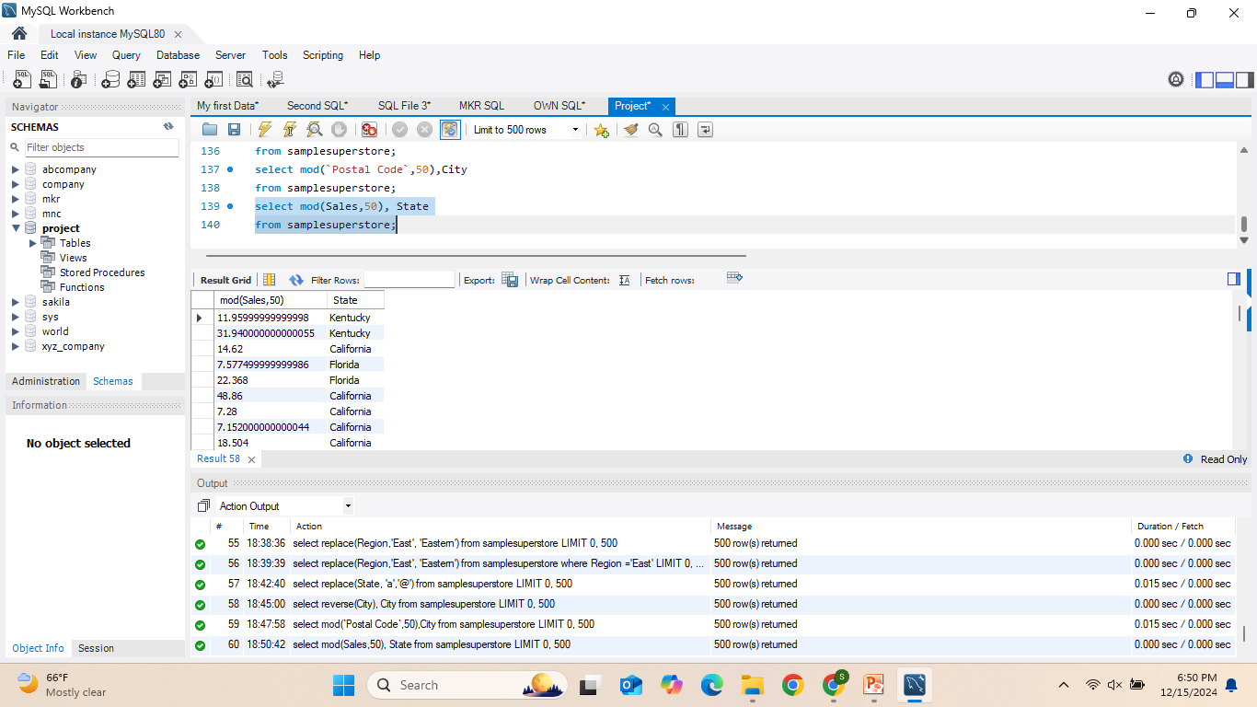
35) Write an SQL query to display the remainder when Sales is divided by 50, along with the corresponding State from the SampleSuperstore table.

Slide 43
Conclusion:
This project covered various SQL commands and queries to interact with the SampleSuperstore database, focusing on data retrieval, manipulation, and analysis.
Key Concepts:
Data Filtering: Using WHERE, AND, OR, IN, BETWEEN, etc.
Aggregation: Using functions like SUM(), AVG(), COUNT(), MAX(), MIN(), and GROUP BY to aggregate data.

Slide 44
Subqueries: Performing nested queries for advanced data analysis.
String Functions: Utilizing functions like UPPER(), SUBSTRING(), REPLACE(), and LENGTH() for data transformation.
Data Sorting and Grouping: Sorting results with ORDER BY and grouping data with GROUP BY, filtering groups with HAVING.
Outcome:
Understanding how to work with and evaluate big datasets has been made easier by the initiative, which has also made it simpler to extract insightful information for commercial decision-making.

Slide 45
Thank you

